Slide 1
搜索算法
Building a fake environment
Legal action
Search algorithm
Trick and weakness
incomplete information
illegal action for simulation
various state
accuracy
shanten
recursion
various details

Slide 2
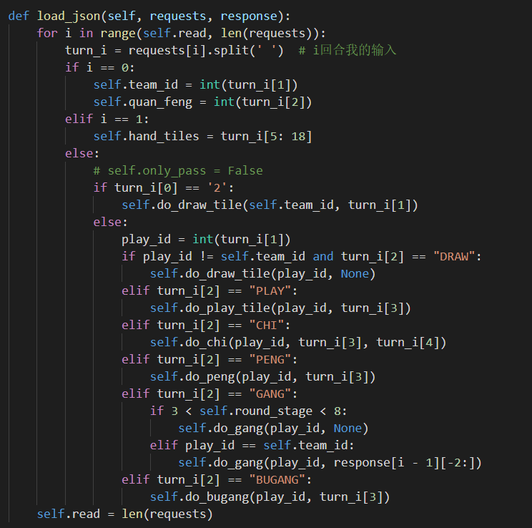
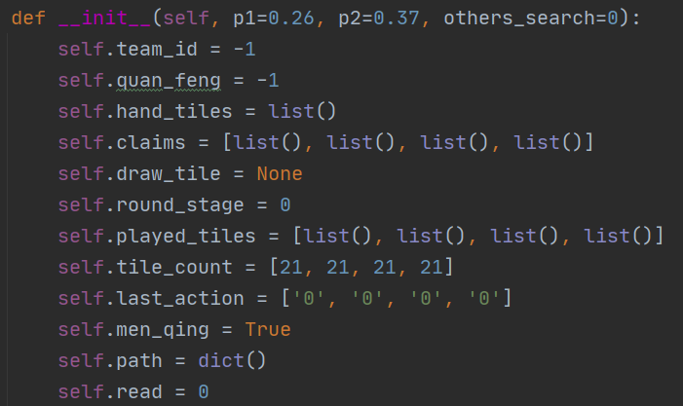
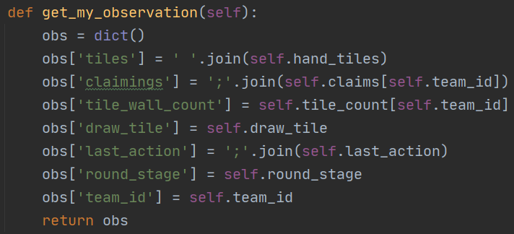
构建环境
Initialize the environment：
Initialize various variables(below)
Load json：
Do draw, play, chi, peng, gang, bugang action(right)
Get observation and time(low right)

Slide 3
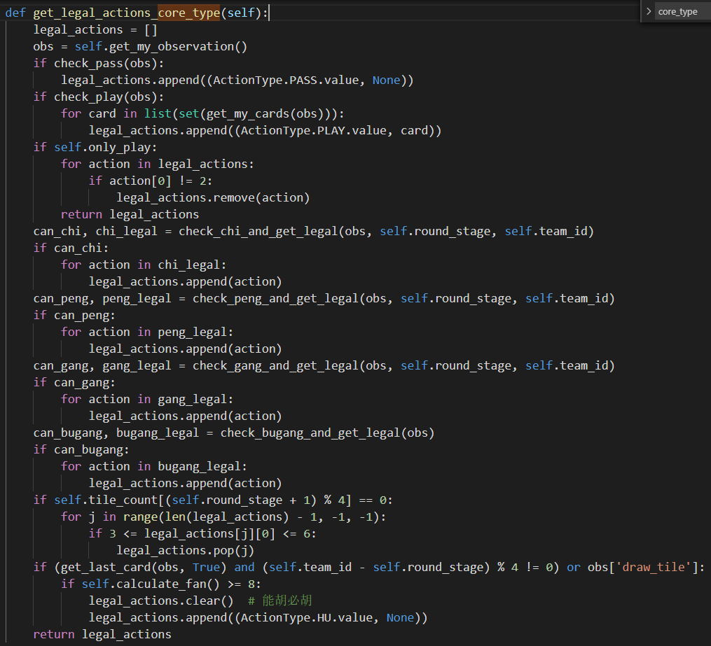
合法动作
Generate legal actions based on current state and Mahjong rules
Use the fan calculator
Hu when it can

Slide 4
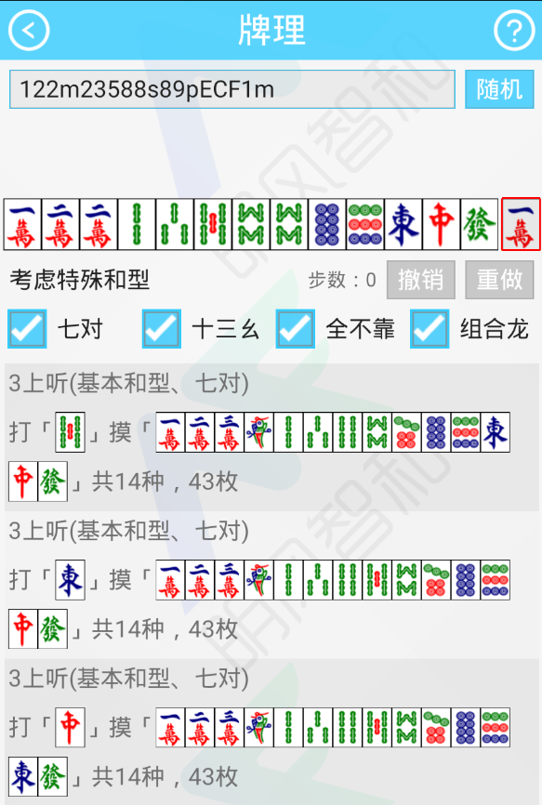
搜索算法
algorithm：
Use shanten algorithm library
https://github.com/summerinsects/ChineseOfficialMahjongHelper
Android apk(picture)
Input: hand tiles(mod 3 == 1) and claimings
Output like this. Each row respectively represents the distance between 13 Orphans, 7 pairs, Lesser Honours and Knitted Tiles, Knitted Straight, General and what tiles we need
Search:
Traverse legal action，after do them, input states to shanten algorithm
Find the smallest distance
In fake env, assume we draw the corresponding card，repeat to step 1
When Hu, get the reward and back propagation

Slide 5
优化和缺点
Trick：
Add constant reward 14.3 to smooth fan
When search to Hu, 26%self draw and 74% discarded by another player
When not search to Hu, we assume General Hu has 36% probability more than 8 fan
When try to Hu General or Knitted Straight, play honours firstly
When try to Hu 13 Orphans, 7 pairs, Lesser Honours and Knitted Tiles, play honours lastly
When search to Hu but fan is less than 8, set this path's distance big enough and search others
When a tile is observed 2 times, we considered a probability to Hu Last Tile
When we have 3 claimings, we considered a probability to Hu Melded Hand
Save node and result when searched
If time up, use artificial value function
weakness：
No consideration of mutual transfer at the same distance
No consideration of opponents' cards
No consideration of defense
Search efficiency is low

